Slide 1
Autonomous Car

Slide 2
HELLO!
Mohamed Emara
Mostafa Ahmed
Omar Wessam
Mostafa Esmail

Slide 3
Descreption
1.

Slide 4
Descreption
This project aims to implement a self-driving Car that can avoid the obstacles with very fast response

Slide 5
Flowchart
2.

Slide 6
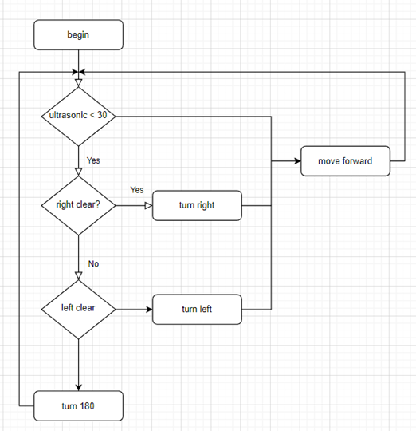
Flowchart

Slide 7
Test
3.

Slide 8
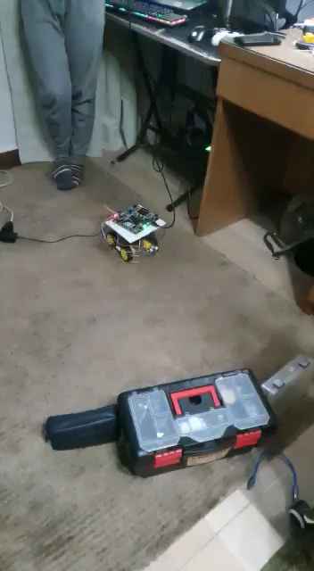
Test

Slide 9
Full code
4.

Slide 10
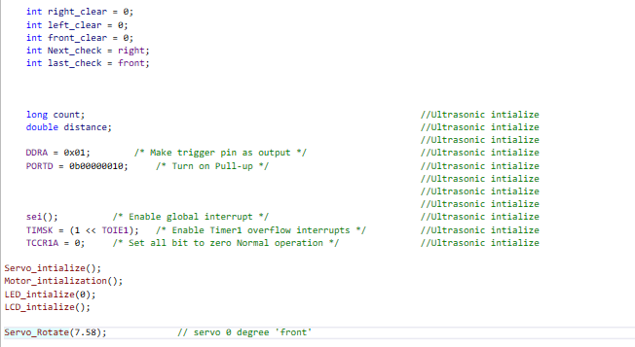
Main.c “intialization”

Slide 11
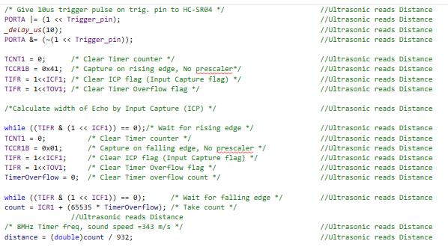
Main.c “while(1) loop” “Distance”

Slide 12
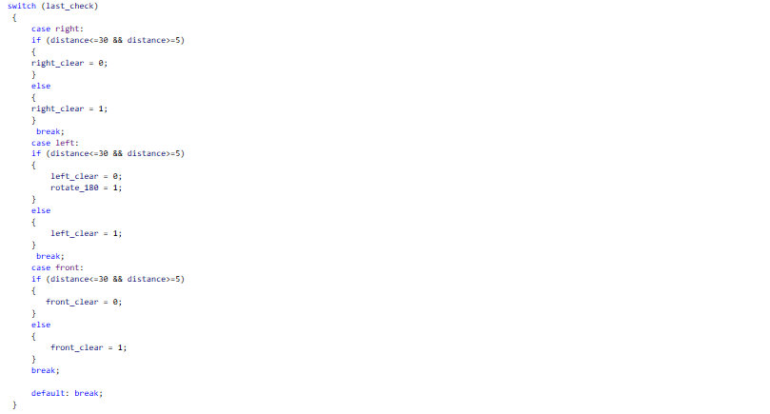
Main.c “while(1) loop” “Assigning obstacle to direction”

Slide 13
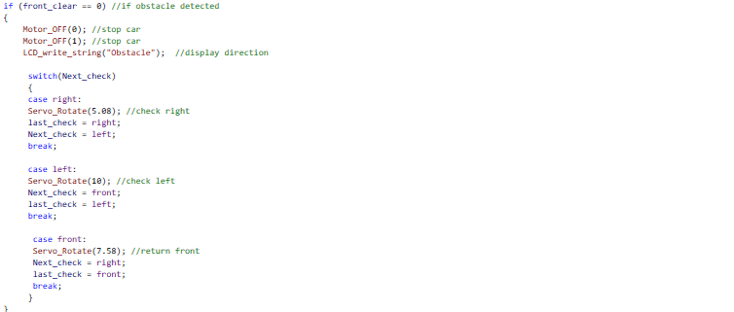
Main.c “while(1) loop” “checking free space”

Slide 14
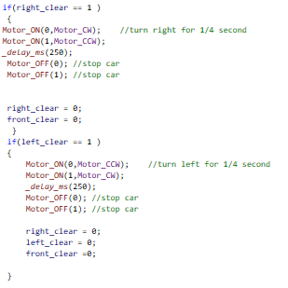
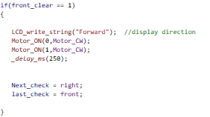
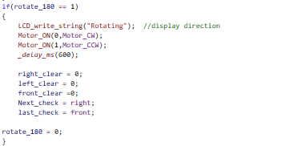
Main.c “while(1) loop” “taking action”

Slide 15
No servo code
4.

Slide 16
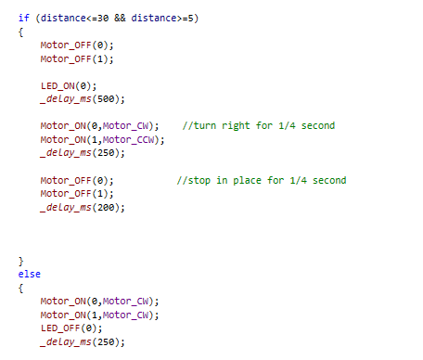
Main.c “no servo”

